Slide 1


Clea Mallinson Julie Smith-Belton Natalya Yoro
登顶

Slide 2
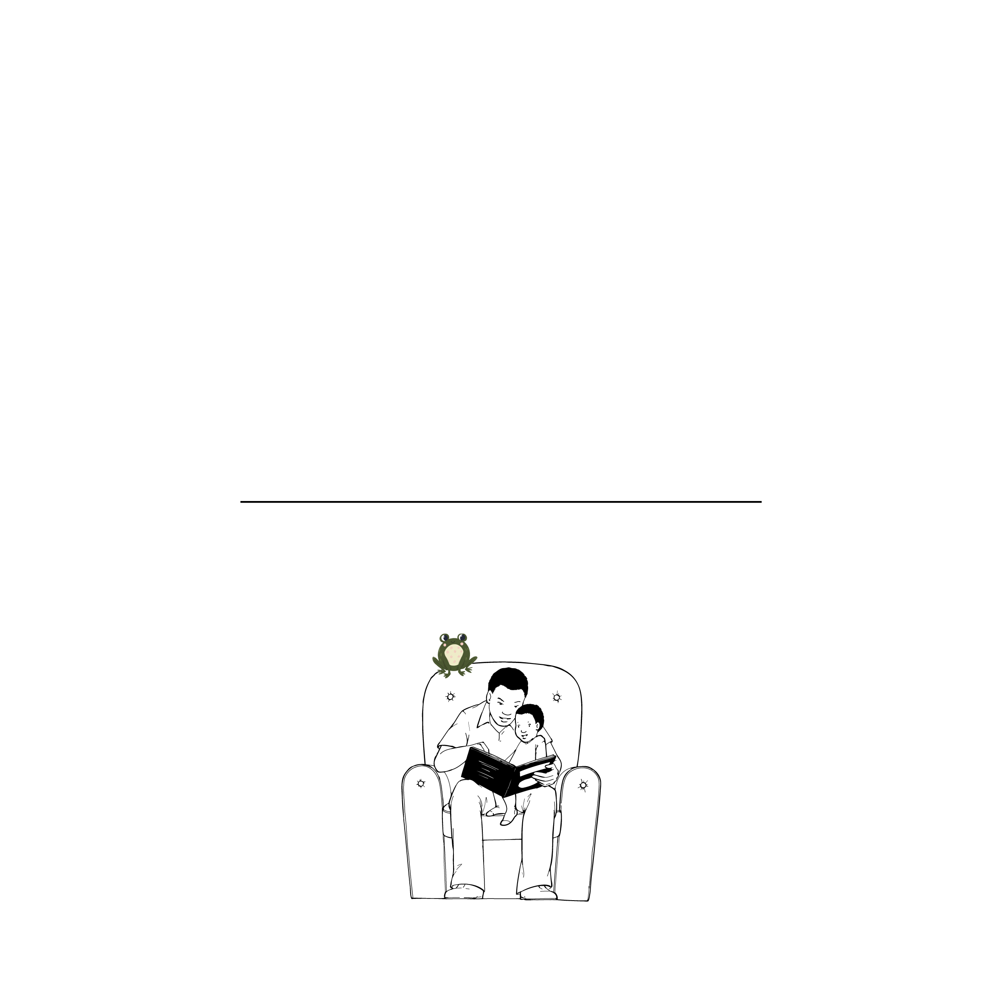
登顶
这本书属于

Slide 3


Slide 4

登顶
Clea Mallinson Julie Smith-Belton Natalya Yoro

Slide 5


Slide 6


Slide 7


Slide 8


Slide 9


Slide 10
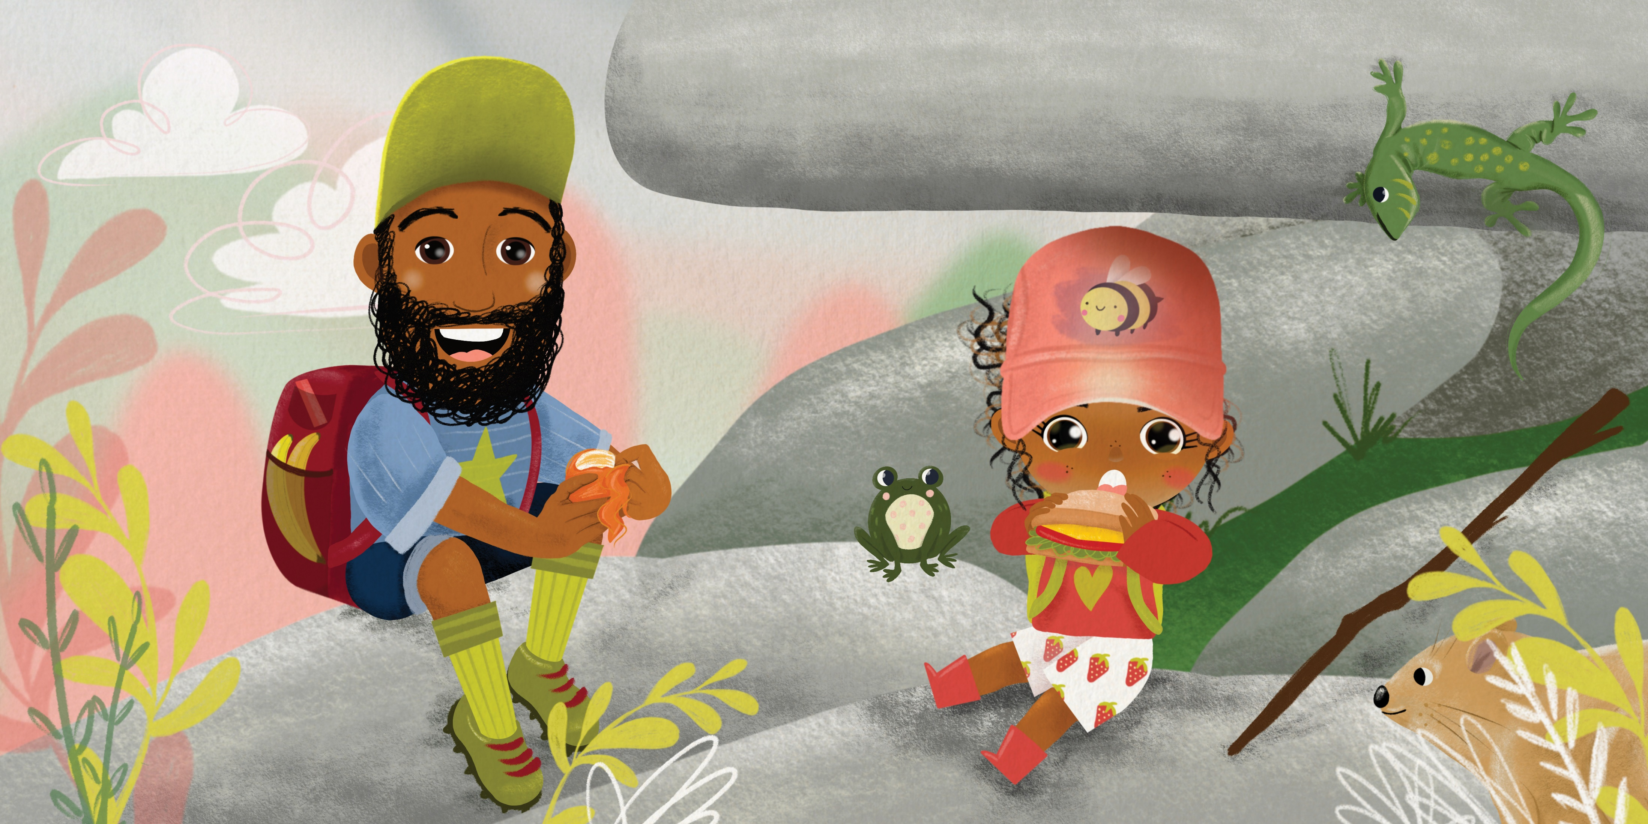

Slide 11


Slide 12


Slide 13


Slide 14


Slide 15


Slide 16


Slide 17


